Slide 1
Kubernetes- Implementation

Slide 2
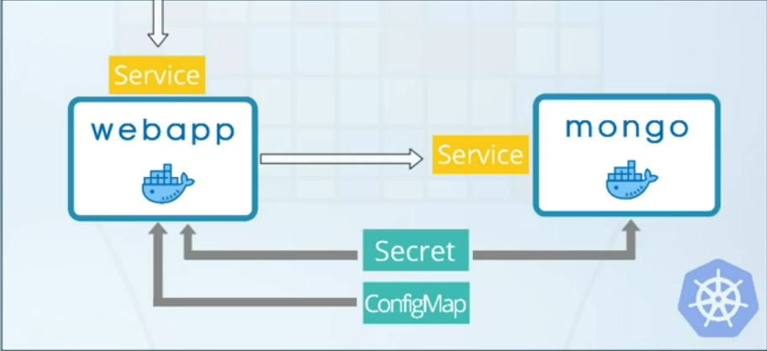
Demo Implementation
A mongoDB application and a web
App which will be connected to
the mongoDB app using the
External configuration data
Secret
ConfigMap

Slide 3
Configuration Files
ConfigMap - MongoDB endpoint
Secret - MongoDB user_id & password
Deployment & Service - MongoDB application with internal service
Deployment & Service - Webapp with external service

Slide 4
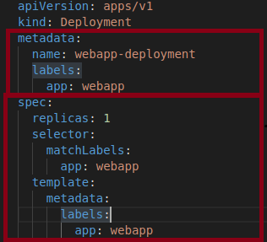
Parts of Configuration Files
Metadata
Specification
Status
Desired State vs Actual State

Slide 5
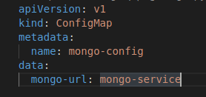
mongo-config.yaml
mongo-url : The service name of mongoDB which is the endpoint of mongoDB.

Slide 6
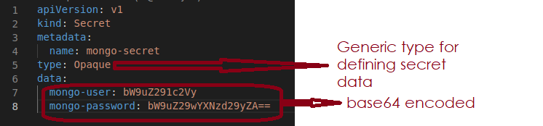
mongo-secret.yaml

Slide 7
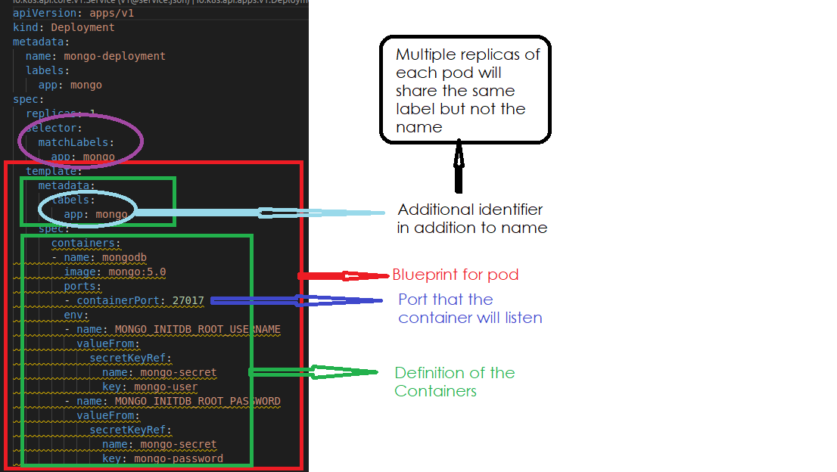
mongo.yaml(Deployment)

Slide 8
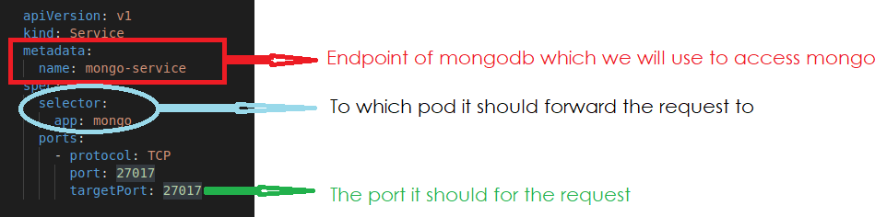
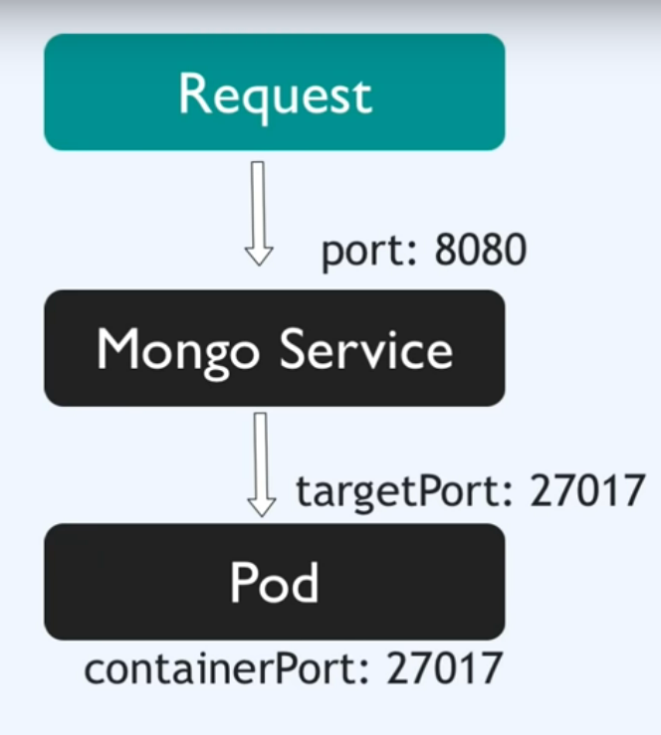
mongo.yaml(Service)

Slide 9

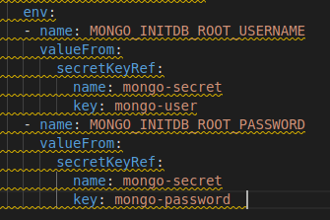
Passing Secret to Mongo Deployment
When the mongodb application starts running, it will automatically generate a username and password. They can be used to access the cluster.

Slide 10
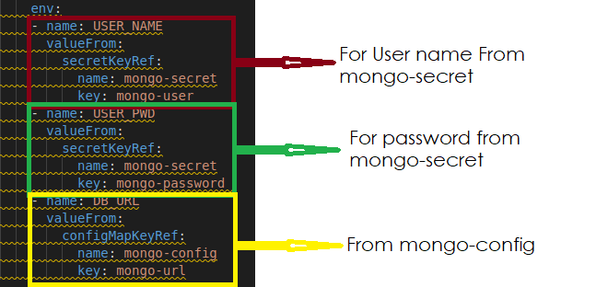
Passing Config Data to Webapp Development

Slide 11
SECCOMP
Secure Computing mode

Slide 12
Basic Idea
Restrict System call to resources
Resources mean Deployments, Pods or Containers
System calls mean Linux Capabilities
Configure or Restrict through profiles
Profiles contain list of system call to allow, deny or audit
Profiles should be located in /var/lib/kubelet/seccomp/profiles
Three types of Profiles:
Audit - logs all system calls at /var/log/syslog
Violation - blocks all system calls
Fine-grained - allows some specific system calls

Slide 13
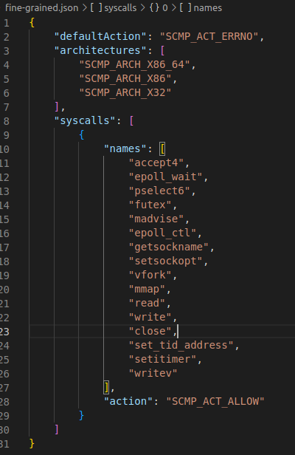

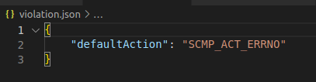
Profile Structure

Slide 14
Implementation Steps
Create any of these three profiles.
Copy the created seccomp profile in all the worker nodes.
Apply profile to all pod SecContext(Security Context)

Slide 15
Step 1: Create Profiles
curl -L -o profiles/audit.json https://k8s.io/examples/pods/security/seccomp/profiles/audit.json
curl -L -o profiles/violation.json https://k8s.io/examples/pods/security/seccomp/profiles/violation.json
curl -L -o profiles/fine-grained.json https://k8s.io/examples/pods/security/seccomp/profiles/fine-grained.json

Slide 16
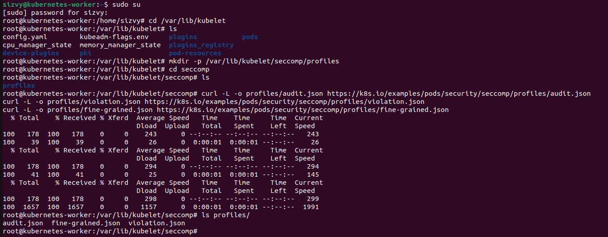
Step 2: Copy Profiles in directory
Copy these json files in /var/lib/kubelet/seccomp/profiles folder. One need to have root privileges for that.

Slide 17
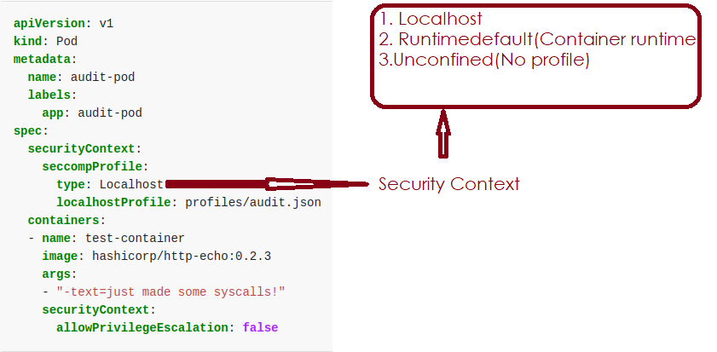
Step 3: Apply Profile to Pod Security Context
First, create a normal pod in the worker-node
Command - kubectl create deployment web –images nginx –replicas 1
Then, create a pod with a profile(audit.json) mounted on it
Notes:
Command to see logs: tail -f /var/log/syslog | grep 'http-echo'

Slide 18
Current Roadblocker
We are currently working on connecting two nodes(in our case, two laptops) using kubernetes master-worker node techniques. But each time we establish a master, after some time the master node gets disconnected.
Using minikube solves the situation for some time but not entirely. Moreover, minikube seems to be a testing tool for kubernetes in local machine which can not be used for real life scenario.

Slide 19
References
https://kubernetes.io/docs/tutorials/security/seccomp/
https://www.youtube.com/watch?v=1KVkORD9oAw&list=WL&index=7&t=968s
https://www.youtube.com/watch?v=s_o8dwzRlu4&t=1563s
https://hub.docker.com/_/mongo
https://www.youtube.com/watch?v=Eo4qHuhod10&list=WL&index=3

